Slide 1
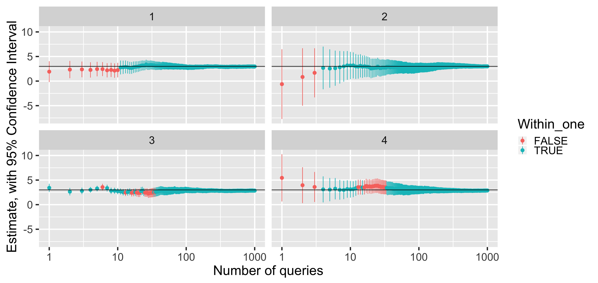
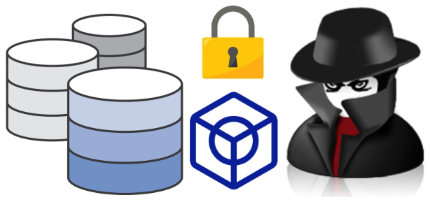
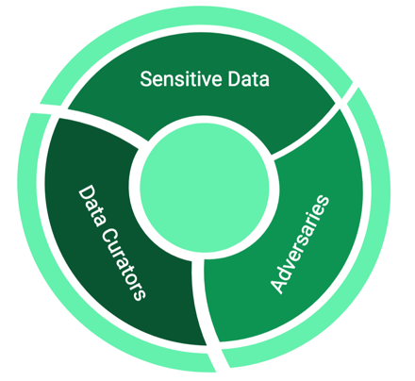
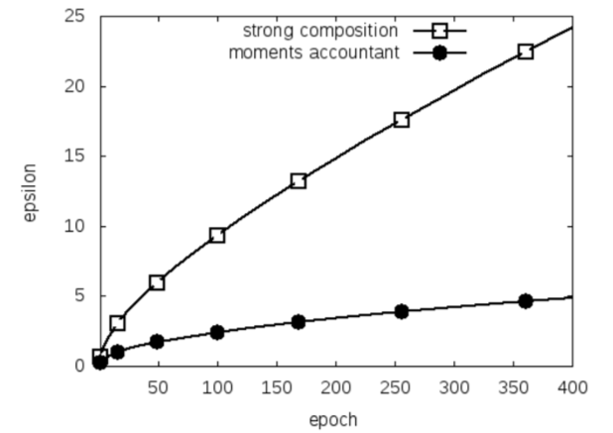
New Algorithms for Differential Privacy
Mary Scott
University of Warwick

Slide 2
Definition of Differential Privacy
Much modern data analysis relies on gathering data from individuals that is considered highly sensitive, e.g. medical history
Highly vulnerable to attack – pressing need to develop trusted and trustworthy systems that limit exposure of sensitive information
Notes:
Large step from motivation bullet to the formalization: lead audience through this transition.
Give cues, e.g. “we will consider a mathematical abstraction”, and “we are sweeping many details under the carpet” to indicate that there is a jump here.

Slide 3
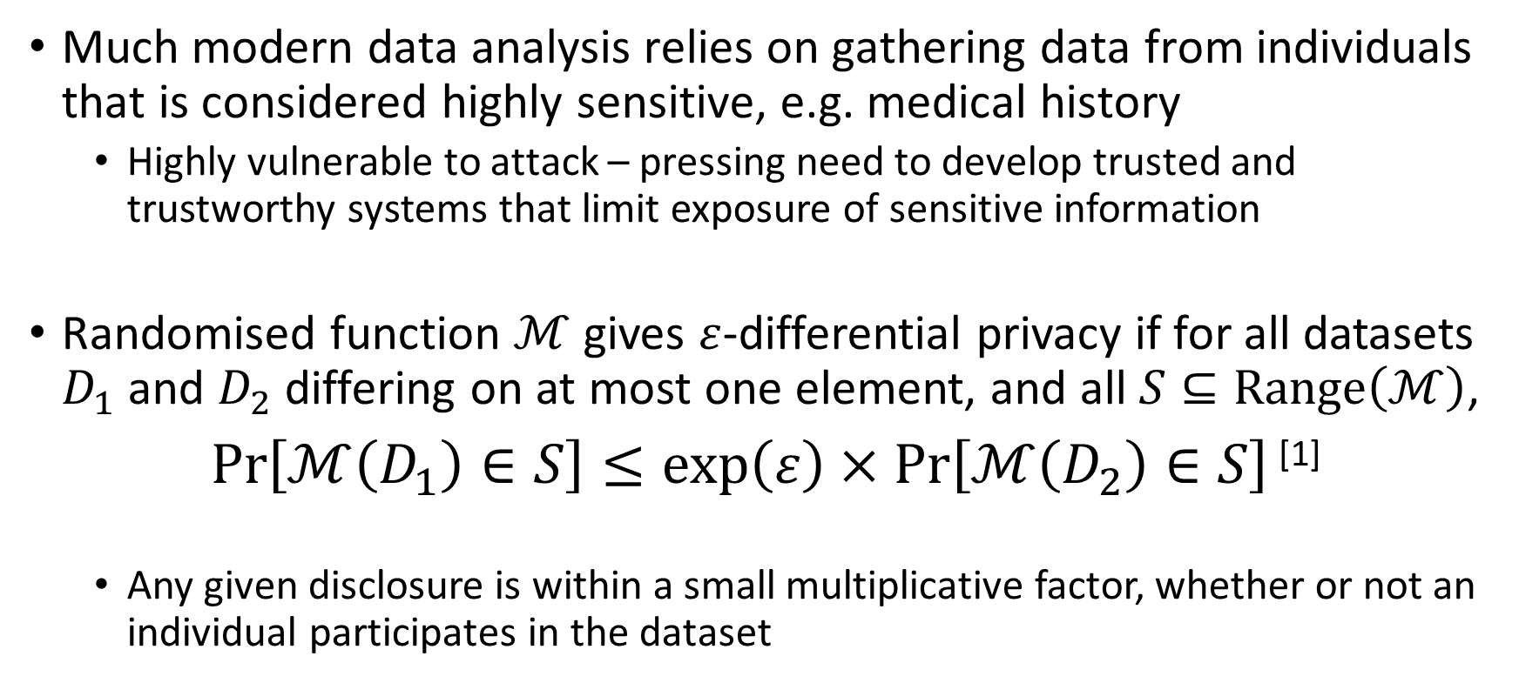
Definition of Differential Privacy
Much modern data analysis relies on gathering data from individuals that is considered highly sensitive, e.g. medical history
Highly vulnerable to attack – pressing need to develop trusted and trustworthy systems that limit exposure of sensitive information
Randomised function $ℳ$ gives $ε$-differential privacy if for all datasets $D_{1}$ and $D_{2}$ differing on at most one element, and all $S⊆Range\left(ℳ\right)$,
$\operatorname{Pr}\left[ℳ\left(D_{1}\right)∈S\right]≤\exp\left(ε\right)×$ $\operatorname{Pr}\left[ℳ\left(D_{2}\right)∈S\right]$ ^{[1]}
Any given disclosure is within a small multiplicative factor, whether or not an individual participates in the dataset
Notes:
“A randomised function M gives epsilon-differential privacy if for all pairs of inputs differing on at most one element, and for every output, the adversary should not be able to distinguish
between the datasets based on any output”. Even if the participant removed their data from the dataset, no outputs (or their consequences) would become significantly more or less likely.

Slide 4

Example of Differential Privacy: Randomised response
Participants report whether or not they have a property $P$:
Flip a coin – if tails, then respond truthfully
If heads, then flip a second coin – respond “Yes” if heads and “No” if tails
“Privacy” – Plausible deniability of any outcome

Slide 5
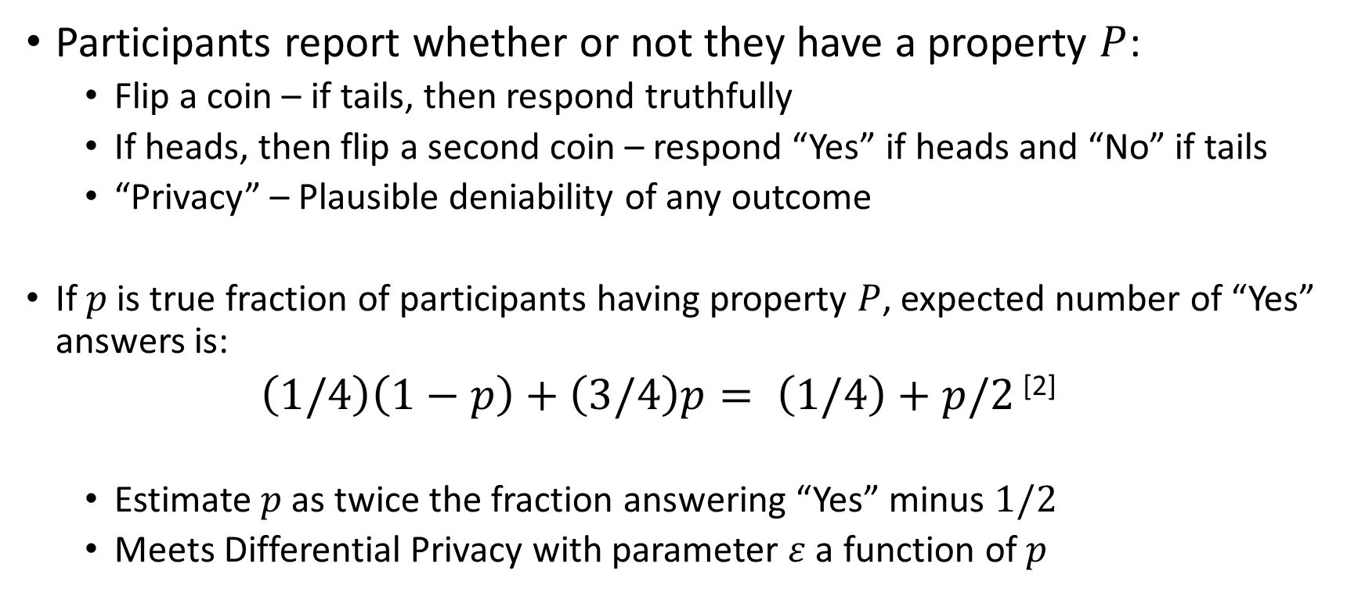
Example of Differential Privacy: Randomised response
Participants report whether or not they have a property $P$:
Flip a coin – if tails, then respond truthfully
If heads, then flip a second coin – respond “Yes” if heads and “No” if tails
“Privacy” – Plausible deniability of any outcome
If $p$ is true fraction of participants having property $P$, expected number of “Yes” answers is:
$\left(1/4\right)\left(1−p\right)+\left(3/4\right)p= \left(1/4\right)+p/2$ ^{[2]}
Estimate $p$ as twice the fraction answering “Yes” minus $1/2$
Meets Differential Privacy with parameter $ε$ a function of $p$
Notes:
If p is the true fraction of participants having property P, the expected number of “Yes” answers is the expected number of “Yes” answers
from the participants having property P, added to the expected number of “Yes” answers from the participants not having property P.

Slide 6
Local Differential Privacy
(Centralized) Differential Privacy – aggregator perturbs the data centrally
Local Differential Privacy (LDP) – each user perturbs the data locally:
Google’s RAPPOR system, to collect web browsing behaviour^{[3]}
Apple’s implementation, to collect usage and typing history^{[4]}

Slide 7
Local Differential Privacy
(Centralized) Differential Privacy – aggregator perturbs the data centrally
Local Differential Privacy (LDP) – each user perturbs the data locally:
Google’s RAPPOR system, to collect web browsing behaviour^{[3]}
Apple’s implementation, to collect usage and typing history^{[4]}
Questions I will consider in my research:
What are the security guarantees in practice?
How broadly can LDP be applied to other data collection tasks?
How can we select when and where to introduce LDP?
Relatively little prior work addressing these questions from this cybersecurity perspective (end-to-end security aspects)

Slide 8
References
[1] C. Dwork. Diﬀerential privacy. In Proceedings of the International Colloquium on Automata, Languages and Programming (ICALP)(2), pp. 1–12, 2006.
[2] C. Dwork and A. Roth. The Algorithmic Foundations of Diﬀerential Privacy. Foundations and Trends®️ in Theoretical Computer Science, vol. 9, nos. 3–4, pp. 211–407, 2014.
[3] Ú. Erlingsson, V. Pihur and A. Korolova. RAPPOR: Randomized Aggregatable Privacy-Preserving Ordinal Response. ACM Conference on Computer and Communications Security, pp. 1054-1067, 2014.

Slide 9
References
[4] “Apple Differential Privacy Team”: Differential Privacy Overview. Available at: https://machinelearning.apple.com/docs/learning-with-privacy-at-scale/appledifferentialprivacysystem.pdf
All pictures are available from Medium:
https://medium.com/georgian-impact-blog/a-brief-introduction-to-differential-privacy-eacf8722283b
https://medium.com/bluecore-engineering/differential-privacy-in-the-real-world-f31a5df1398f

